Slide 1
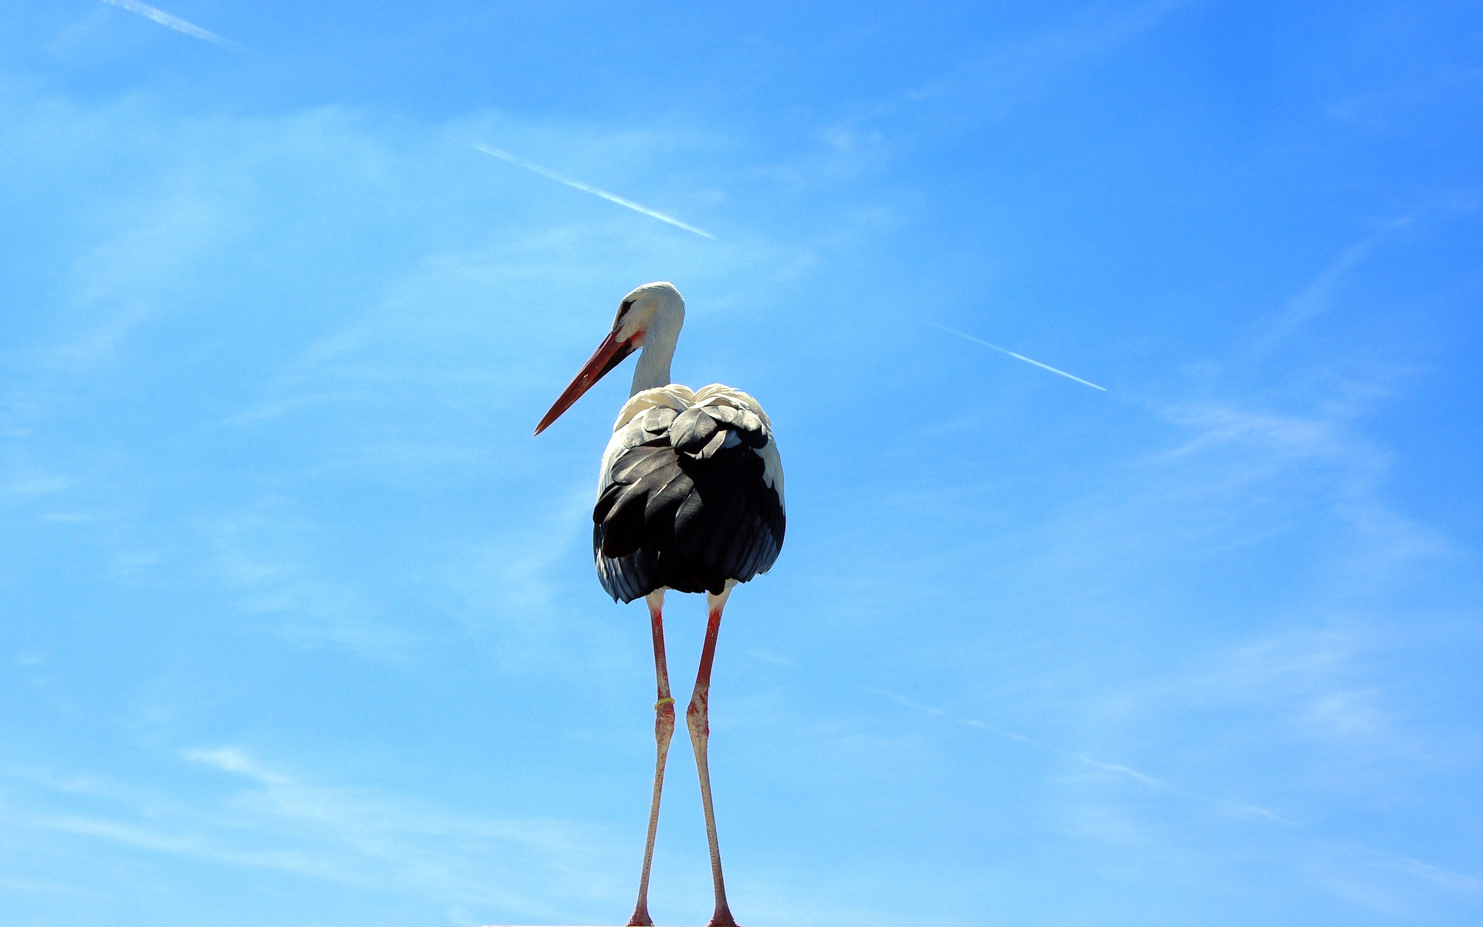
PRESCRIPTION VS. DESCRIPTION
BQ5 Creativity Lesson 6
I can evaluate the extent to which language is ‘living’
Notes:
See how this lesson links to the course by viewing the final slide
Key TOK terms appear in a red font

Slide 2
Starter
Taylor Swift on having a traumatic summer in 2019:
“I was literally about to break”
Steven Pinker’s reaction to her use of this expression:
“The newest member of A.W.F.U.L. (Americans Who Figuratively Use ‘Literally’)”
Was Pinker right to be critical of Taylor Swift?
How important is it to use vocabulary ‘correctly’?
What do you think a ‘linguistic pedant’ is?
Notes:
See this article for more details about Swift vs. Pinker. Make sure students understand why he was unhappy.
In some ways, it’s vitally important to use vocabulary ‘correctly’ - to ensure that ideas and theories are communicated accurately.
On the other hand, who makes these rules? Can the power behind the rules be trusted? Etc.

Slide 3
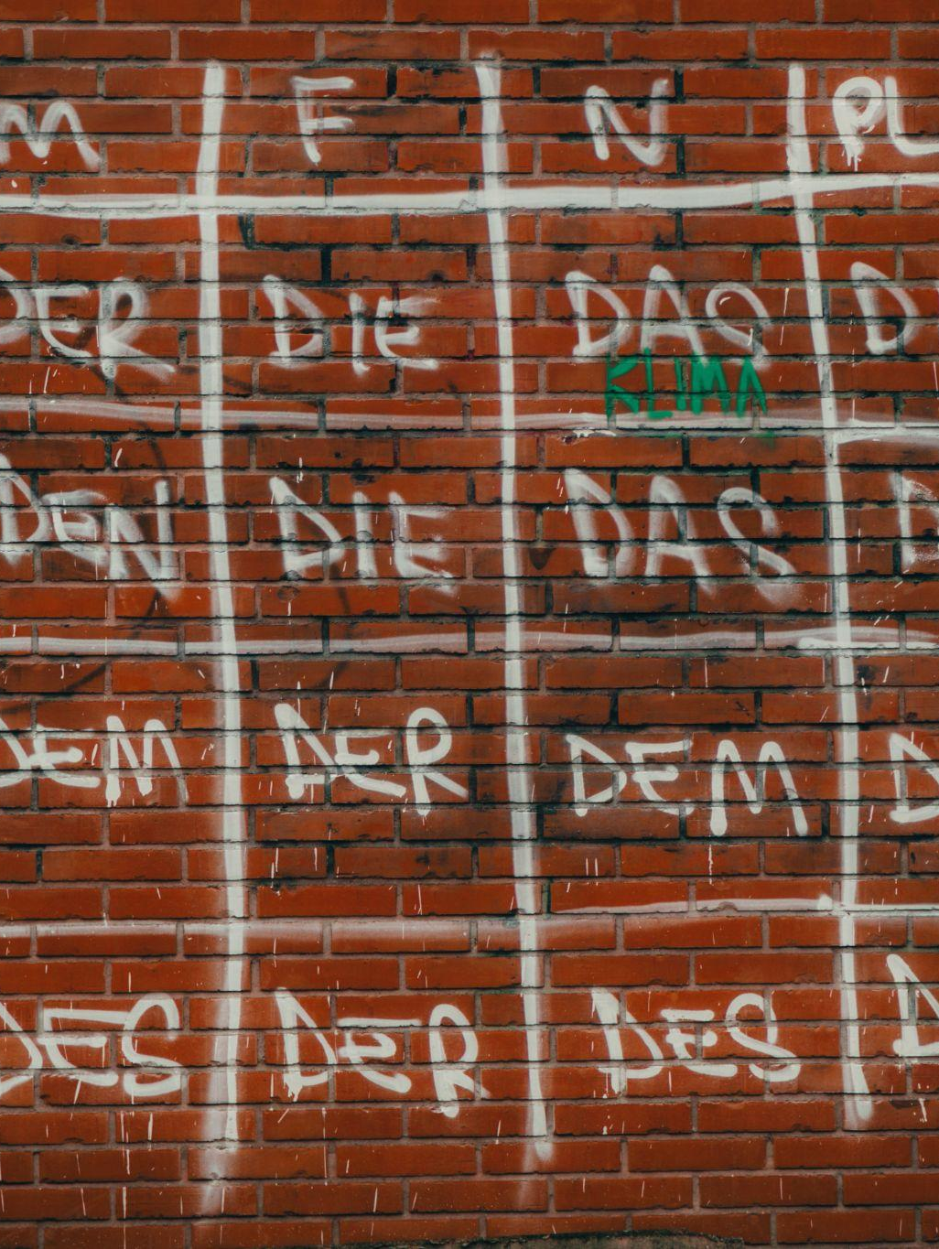
Language under attack?
Read your article. Consider -
Which language does your article feature as being ‘under attack’ and how?
Which power is keen to prevent this from happening?
What does this reveal about how some people view: a) the relationship between culture and language; b) the nature of language in terms of change and stability?
Talk to one other group, and jot down their responses.
Overall, do you believe that language needs ‘protecting’?
Notes:
There are three articles -
The Academie Francaise bans certain words in English
Singapore tries to ban ‘Singlish’
Take my word for it, the English language is facing destruction
Allocate pairs or groups one of these articles, and ask them to follow the instructions above.
Discussion should be based on the idea that languages are something monolithic, that need to be protected from attack from the outside, and preserved as they are.
At this point, don’t question the viability of that, instead, acknowledge that there is a very important relationship between culture and language - language helps to define who we are, individually, and as a culture.

Slide 4
Think/write/share
In most cultures, the ‘authority’ for language is the dictionary.
Write down a definition of what a dictionary is, and its main purpose.
Notes:
Share ideas.
Ascertain whether students think dictionaries are primarily descriptive or prescriptive - in other words, are they there to tell us how people use language, or how language should be used?

Slide 5
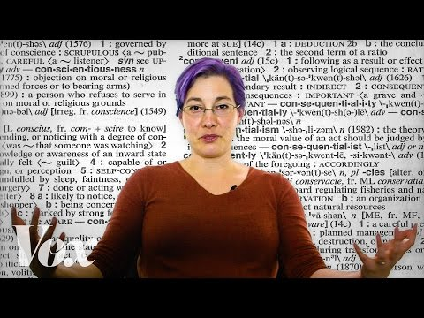
Kory Stamper on the nature of dictionaries
Explain what Kory Stamper means when she refers to English (and language in general) as being like ‘a river’.
Include ‘descriptivism’ and ‘prescriptivism’ in your answer
Notes:
The whole video (9 minutes) is useful and engaging, but you can shorten it by watching from 4.25.
The two words to focus on are ‘prescriptive’ and ‘descriptive’. Stamper reveals that dictionaries are very much about the latter.
Language is constantly evolving; she mentions the word ‘Sprachgefuhl’ as being used in English, and talks also about context a lot. Language is, in short, alive!

Slide 6
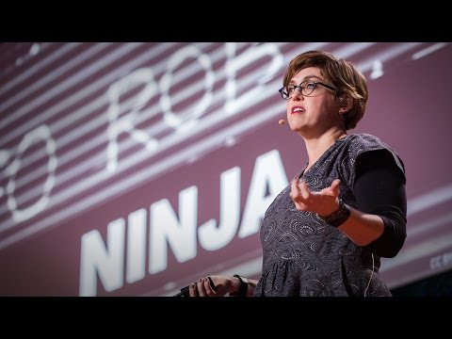
Erin McKean on new words
What is Erin McKean’s definition of language?
Make up some new words, using McKean’s different methods. Include a definition for your words.
For inspiration, consult Douglas Adams.
Notes:
OPTIONAL SLIDE.
The video lasts just under 7 minutes.
McKean asserts that ‘Every language is a group of people who decide to understand each other.’
In other words, the people using the language are the ultimate authority of the language.
Her six ways of creating new words are -
Steal
Compound
Blend
Functional shift
Back formation
Making words from acronyms (my word!)
The link to Douglas Adams takes you to his ‘Meaning of Liff’ page, in which he created a whole dictionary of created words for certain feelings and situations.
Share ideas; the best ones can be displayed

Slide 7
Links to the TOK exhibition
Related exhibition prompt What role do experts play in influencing our consumption or acquisition of knowledge? (IAP-22)
Refer to the ideas from this lesson to answer this question.
For example, think about who (or what) is an ‘expert’ on language, and the way they influence the way we use language to express our ideas about the world.
Which objects could help to illustrate your answer?
Notes:
Optional slide, if you want to help students to take ownership of the IA prompts (IAPs) for the TOK exhibition

Slide 8
“Language is a living thing. We can feel it changing. Parts of it become old: they drop off and are forgotten. New pieces bud out, spread into leaves, and become big branches, proliferating.” (Gilbert Highet)
Do you agree? Justify your answer, supporting it with examples.
Notes:
See the BQ5 assessment tracker for suggestions on providing feedback, and recording students’ progress.

Slide 9
Linking this lesson to the course
During this lesson, we consider the highlighted aspects of the TOK course
The images used in the presentation slides can also give students ideas about selecting exhibition objects; see also our link below to specific IA prompts
CORE THEME | OPTIONAL THEMES | AREAS OF KNOWLEDGE | TOK ASSESSMENT
Knowledge & the knower | Indigenous societies | The arts | The TOK essay
 | Language | History
 | Politics | The human sciences | The TOK exhibition Could be linked to IAP-9 (interpretation), IAP-22 (experts), IAP-33 (development)
 | Religion | Mathematics
 | Technology | The natural sciences

Slide 10
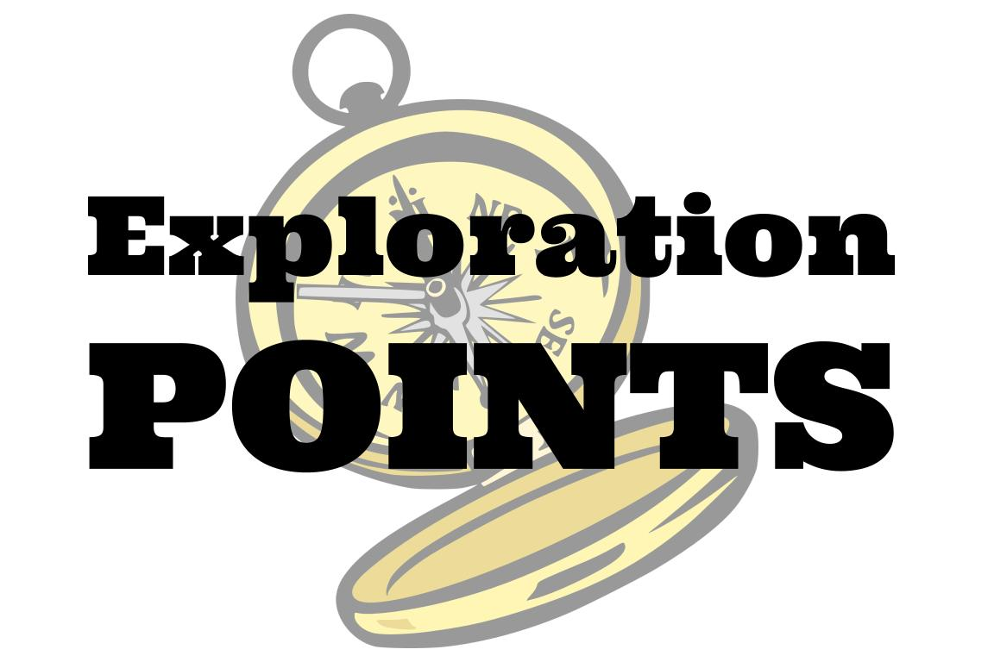
Explore the TOK themes and areas of knowledge in more depth via a range of thinkers, media sources, and other resources, in our EXPLORATION POINTS DOCUMENTS.
Access the documents via the links below. You’ll also find the EP icons on all of the TOK course pages of the site to help you unpack the quotes, KQs, and real-life situations that you find there.
CORE THEME
Knowledge & the knower
OPTIONAL THEMES
Indigenous societies
Language
Politics
Religion
Technology
AREAS OF KNOWLEDGE
The arts
History
Human sciences
Mathematics
Natural sciences
Notes:
Use this slide to access the ‘Exploration Points’ notes for BQ5, which will help students to develop a deeper knowledge of any TOK theme or area of knowledge. This will not only help them to master the TOK course in general, but also craft a great exhibition or essay.
Be ready to provide more guidance on how to use this resource - ie, which media sources to focus on, which questions to address, which TED talks to watch, and which key terms and ideas to understand.

